Slide 1
Efficient Scheduler Live Update for Linux Kernel with Modularization
2023/07/17 システム情報専攻
江 松穎

Slide 2
Information
Authors
Alibaba Group Teng Ma Shanpei Chen Yihao Wu Erwei Deng Zhuo Song
Shanghai Jiao Tong University Quan Chen Minyi Guo
Proposed Conference
ASPLOS 2023 — 28th ACM International Conference on Architectural Support for Programming languages and Operating Systems

Slide 3
Outline
Background
Prior Researches
System Design
Evaluation
Summary

Slide 4
Background – The Linux Scheduler
The scheduler is one of the most critical and complicated subsystem in the OS.
Depends on the synchronization primitives
E.g., RCU (Read-Copy-Write) / Interrupts
Interacts with other subsystems
E.g., Memory Management
Sizeable
>27 KLOC, also >60 Files
Direct impacts many metrices — Scheduling latency, CPU Utilization, etc

Slide 5
Background — Problem of Schedulers
Workload Has Different Features ➡ Difficult to Develop One-Fit-All Scheduler
CFS Scheduler, default for current Linux kernel,
Uses ~7.6% of CPU cycles when ~1000 container co-run on single node in cloud scenario
Using Workload-Specific Schedulers Helps:
Tableau Scheduler
Web service applications, improved throughput by 1.6x
Calandan Scheduler
Network request, improved tail-latency by 11,000x
However, updating scheduler is costly

Slide 6
Background — Replacing Schedulers
Traditrional Straight Forward Update Steps
Server Downtime
Patch Fix
Recompile OS
Reboot OS
Re-initialize HW
Restart upper-layer application
VM-Migration technique enables live-update & speeds things up, but...
Migration (with network) time grows as thread number increases
Having >10,000 thread on recent server now is normal
Minutes of downtime while migration
Minute-level downtime is unacceptable, aim for 10ms or lower

Slide 7
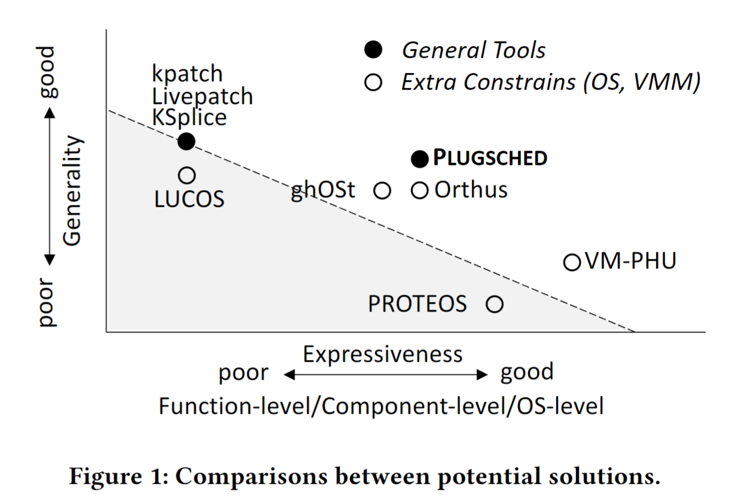
Prior Researches
PROTEOS
Only for microkernel
VM-PHU
Only for guest kernel in VM
ghOSt
Scheduler update in user space
Server code modification required
Only for scheduler class
Introduce more overhead
PLUGSCHED
System proposed by paper

Slide 8
System Design — Design Goals
Adequate expressiveness
Support component-level live update
Data state should also be migratable
High generality
Can be applied to Linux servers without constraints
No need to change kernel code
Achieve both short downtime and safety
Minimum downtime
No damage to system — clear boundary and atomic update
Easy-to-use
Provide common live-update tools
Upgrade / Rollback should be done by install/uninstall scheduler module

Slide 9


System Design — Overview
Development
1
2
3
4
Information
Gathering
Boundary
Analysis
Code Extraction
/kernel/sched/xxxx
Scheduler Developing
5
Compiling
Scheduler Modularization
8
7
6
Data
Update
Function
Redirection
Stack
Inspection
Load / Unload Module
.rpm (module)
Kernel
Deployment

Slide 10
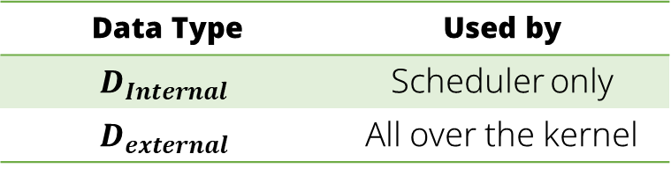
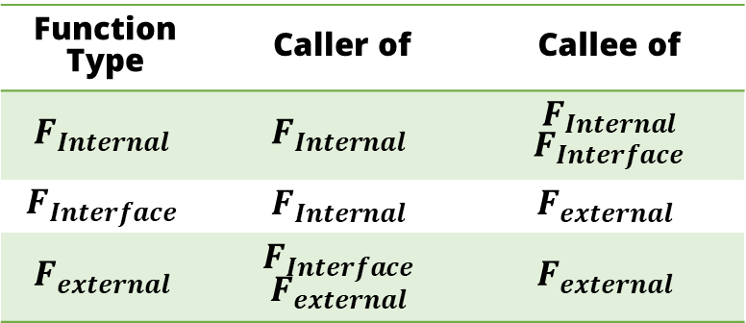
System Design — Scheduler Modularization①
Scheduler related files are under /kernel/sched but...
Not all function / data are relevant
We cannot move these out since we cannot modify kernel code
Function Based Boundary
Classify function / data to different type
Function Type | Caller of | Callee of
$$F_{Internal}$$ | $$F_{Internal}$$ | $F_{Internal}$ $F_{Interface}$
$$F_{Interface}$$ | $$F_{Internal}$$ | $$F_{external}$$
$$F_{external}$$ | $$F_{Interface}$$ $$F_{external}$$ | $$F_{external}$$
Data Type | Used by
$$D_{Internal}$$ | Scheduler only
$$D_{external}$$ | All over the kernel

Slide 11
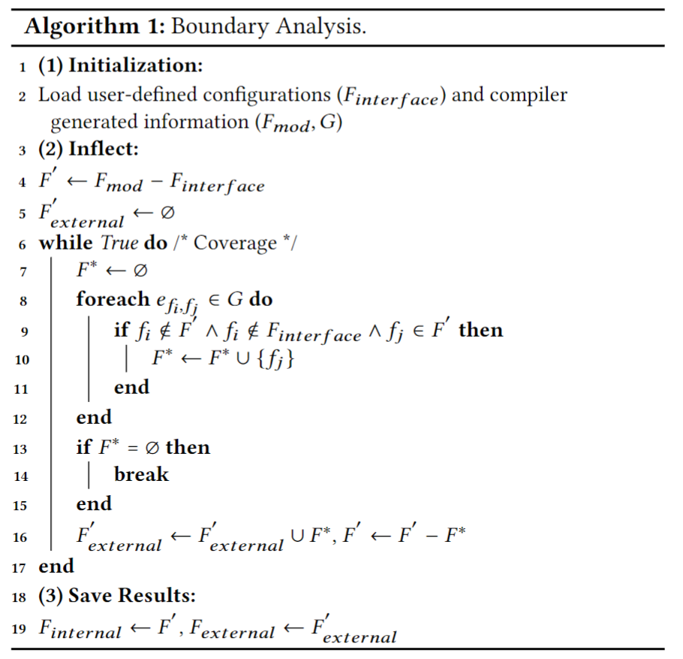
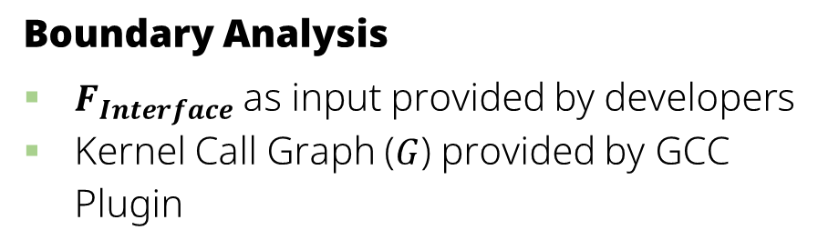
System Design — Scheduler Modularization②
Boundary Analysis
$F_{Interface}$as input provided by developers
Kernel Call Graph ($G$) provided by GCC Plugin

Slide 12
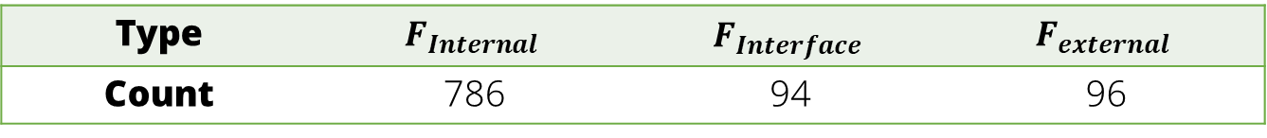
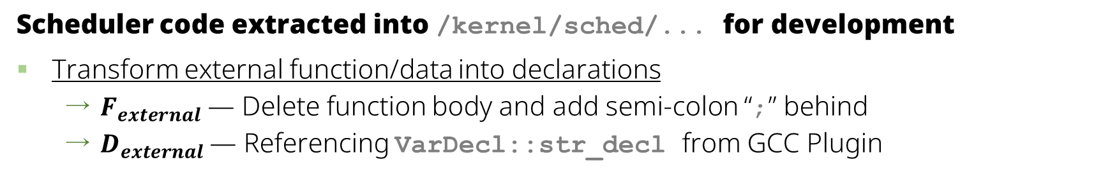
System Design — Scheduler Modularization③
Scheduler code extracted into /kernel/sched/... for development
Transform external function/data into declarations
$F_{external}$ — Delete function body and add semi-colon “;” behind
$D_{external}$— Referencing VarDecl::str_decl from GCC Plugin
Classification result for Linux 4.19
Type | $$F_{Internal}$$ | $$F_{Interface}$$ | $$F_{external}$$
Count | 786 | 94 | 96

Slide 13
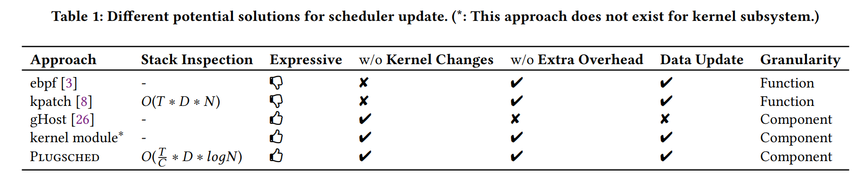
System Design — Stack Inspection
Uses technique similar to other approaches (kpatch), just better
Compare call stack with old functions to make sure that, after update, threads will not execute text from old scheduler.
stop_machine() to halt system
Parallel Checking: kpatch uses only one CPU Core, PLUGSCHED uses the whole CPU
When traversing function list, use binary search

Slide 14
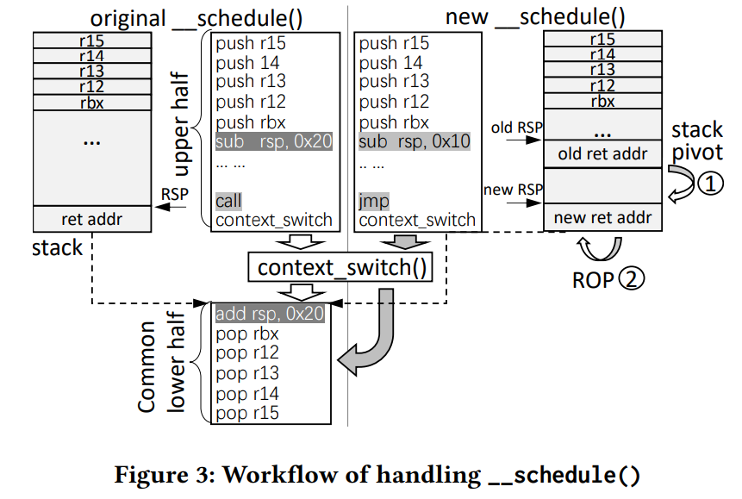
System Design — Function Redirection
Achieved by replacing instructions
First instruction of old function is replaced by JMP instruction, towards the new function
Only exception, __schedule()
Sleeping thread returns to old __schedule()
All scheduling decision is done before context_switch()
New function only does the upper part, then jump to old context_switch()

Slide 15
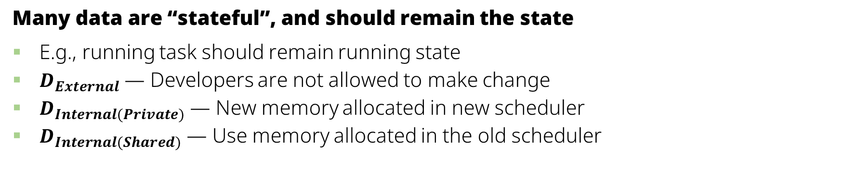
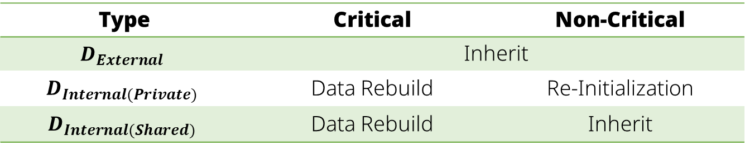
System Design — Data Update
Many data are “stateful”, and should remain the state
E.g., running task should remain running state
$D_{External}$ — Developers are not allowed to make change
$D_{Internal(Private)}$ — New memory allocated in new scheduler
$D_{Internal(Shared)}$ — Use memory allocated in the old scheduler
Internal data also has differences
Critical data must be rebuilt from the ground up. E.g., struct cfs_rq
Type | Critical | Non-Critical
$$D_{External}$$ | Inherit
$$D_{Internal(Private)}$$ | Data Rebuild | Re-Initialization
$$D_{Internal(Shared)}$$ | Data Rebuild | Inherit

Slide 16

Evaluation — Experiment Setup
CPU
Intel Xeon(R) Platinum 8163 CPU @ 2.50GHz
Dual-socket, 48 core, 32MB L3 Cache
Platforms
x86_64
ARM64
Implementation
Python — ~2,000 LOC
C — ~6,000 LOC
Memory
192GB
Linux Kernel
v4.19.91
https://github.com/aliyun/plugsched

Slide 17
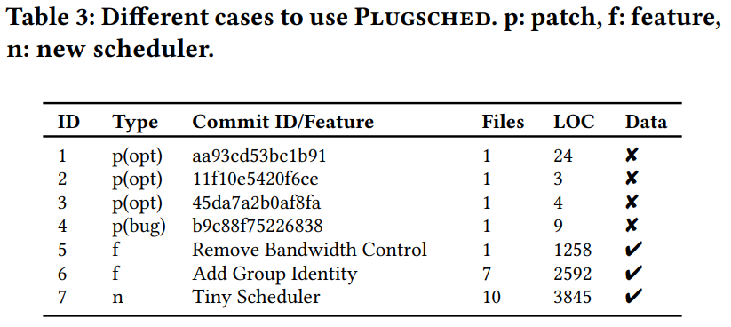
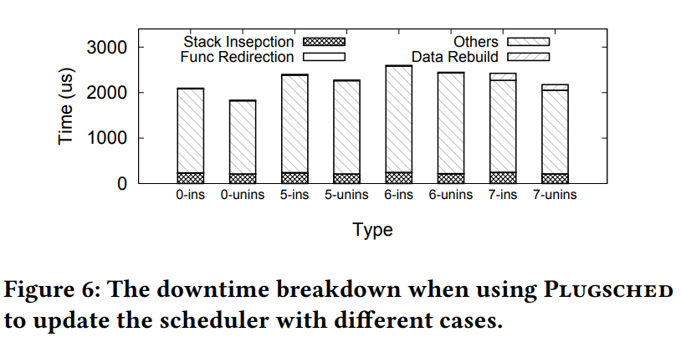
Evaluation — Downtime on Different Cases
3 Types of Update
Patch — Minor changes / fixes
Feature — Add component to current scheduler
New Scheduler —
Entire scheduler revamp
Update size does not affect downtime

Slide 18
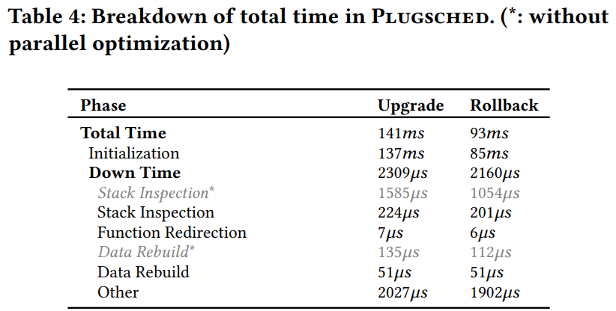
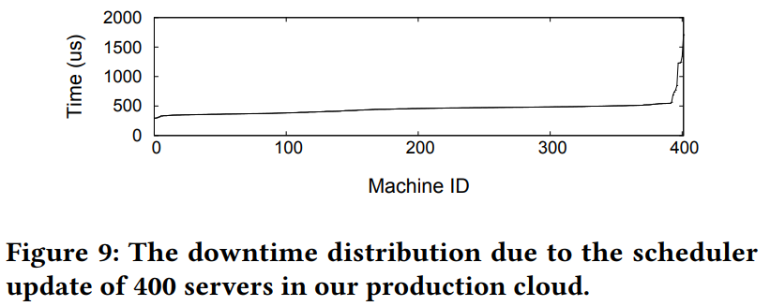
Evaluation — General Downtime Breakdown
On test environment with no workload no parallel optimization, downtime ~2ms for both install and uninstall
On real environment with workloads with parallel optimization, almost all downtime is less then 1ms
98% time is for initialization, causes no effect on downtime

Slide 19
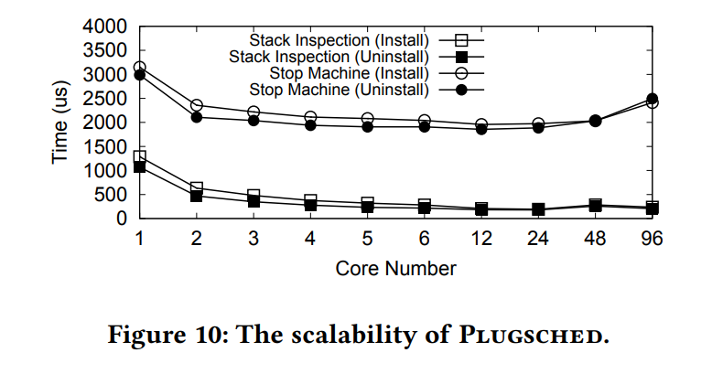
Evaluation — Scalability
Speed goes up until ~24 cores, but 6 core is sufficient
Suboptimal scalability due to
Workloads are not perfectly balanced
Starting SI (Stack Inspection) costs milliseconds, negates the tiny improvement for more core
1
6
24

Slide 20
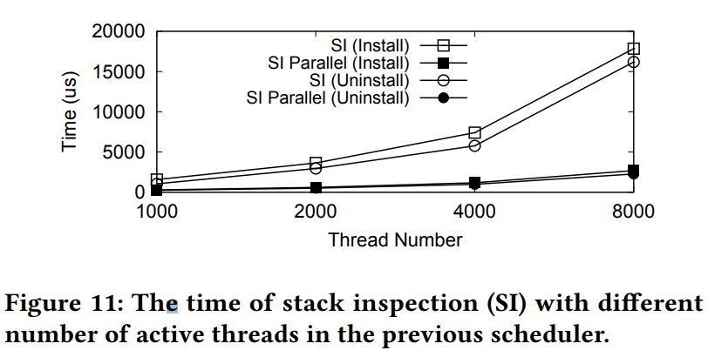
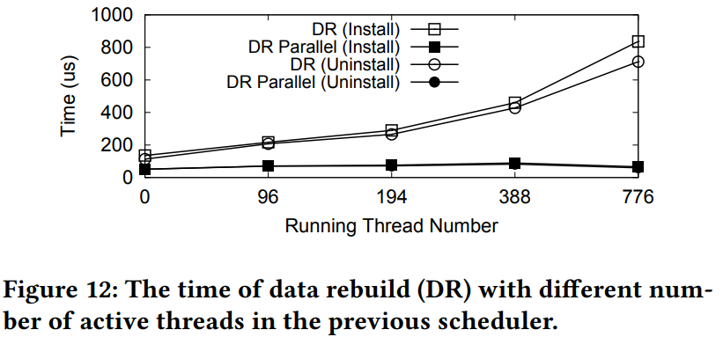
Evaluation — Parallel SI(Stack Inspection) / DR (Data Rebuild)
Test with no parallel optimization / parallel using 6 cores
SI — Linear time for both scenario
DR — With parallel optimization, constant time while running thread number grow

Slide 21
Summary
Sometimes, we need to update the scheduler to fit workloads
We must do it with minimal downtime
PLUGSCHED enables scheduler live-update with good generality
With function/data analysis, scheduler code can be extracted to develop update
Update into module provides easy install
Just inspect stack, redirect function, and update data
Same modularization technique could be used on other components for future work

